Slide 1

By Group 16:
Naaz Bhagat (1803678)
Nimran Kaur Atwal (1803680)
Rushil Gandhi (1803694)
Sharanpreet Singh(1803700)

Slide 2
Contents
Introduction
Scope
Tools and Technology
Back End
Middle Ware
Front End
Future Scope

Slide 3
Introduction
Find Your Movie is an online platform for the users which prefer looking for ratings at different movie rating websites before making a decision about what movie to watch.
This saves time for the users of going to different web sites and searching for different lists in order to get the results while making a choice while finding a movie.
Here the user has the convenience of selecting their favorite genre and year to filter out the top movies according to their selections.

Slide 4
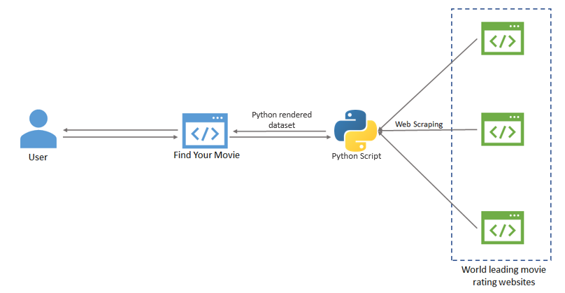
Scope
Find Your Movie web app takes input from the user giving them drop downs to apply filters and get the results according to the preference of the user.
The aim is to give users the ease of getting lists from different world leading movie rating websites and bring them to one place.
We achieve this using a sophisticated web scraping function which constantly collects data from these web sites and maintains our database to give users the lists according to the selections the user enters.
The aim of this web application is to give users the ease of finding their movie according to their preference and also being able to compare the ratings given by different movie rating websites along with a very simple and responsive UI.

Slide 5
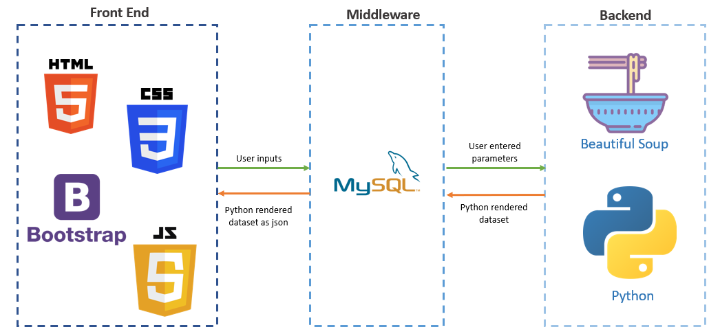
Tools and Technologies
Back End
Middle Ware
Front End
Web Scraping in Python
BeautifulSoup, Pandas & Requests
MySQL
HTML & JavaScript
CSS & Bootstrap

Slide 6
Back End

Slide 7
Web Scraping in Python
Web scraping is a term used to describe the use of a program or algorithm to extract and process large amounts of data from the web. When you run the code for web scraping, a request is sent to the URL that you have mentioned. As a response to the request, the server sends the data and allows you to read the HTML or XML page. The code then, parses the HTML or XML page, finds the data and extracts it.
In our project web scraping is used to scrape data from IMDB and Rotten Tomatoes websites. So, all the movie data comes from there.

Slide 8
Modules Used
BeautifulSoup
Pandas
Requests
Beautiful Soup is a pure Python library for extracting structured data from a website. It allows you to parse data from HTML and XML files. It acts as a helper module and interacts with HTML in a similar and better way as to how you would interact with a web page using other available developer tools.
In our project beautiful soup is used to parse over the data of IMDB and Rotten Tomatoes Website
Pandas is a software library written for the Python programming language for data manipulation and analysis. In particular, it offers data structures and operations for manipulating numerical tables and time series.
It allows importing data from various file formats such as comma-separated values, JSON, SQL, Microsoft Excel.
In our project Pandas are used to make a dataframe table of the movies scraped from IMDB.
Requests will allow you to send HTTP/1.1 requests using Python. With it, you can add content like headers, form data, multipart files, and parameters via simple Python libraries. It also allows you to access the response data of Python in the same way
The HTTP request returns a Response Object with all the response data (content, encoding, status, etc).

Slide 9
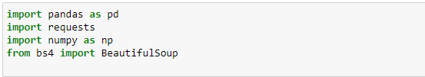


Back End Code
First we import the necessary modules and methods
We insert the desired url and get the response from the requests module and parse through the data using BeautifulSoup.
With this we can see the documentation of BeautifulSoup and all the methods that are available to work with.

Slide 10
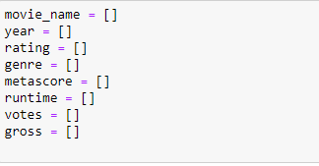
Back End Code
Then we make lists for all the columns we need.
Next, we use the ‘findAll’ function to enter into a particular area i.e. ‘div’ which lets us access all the attributes of that class.

Slide 11
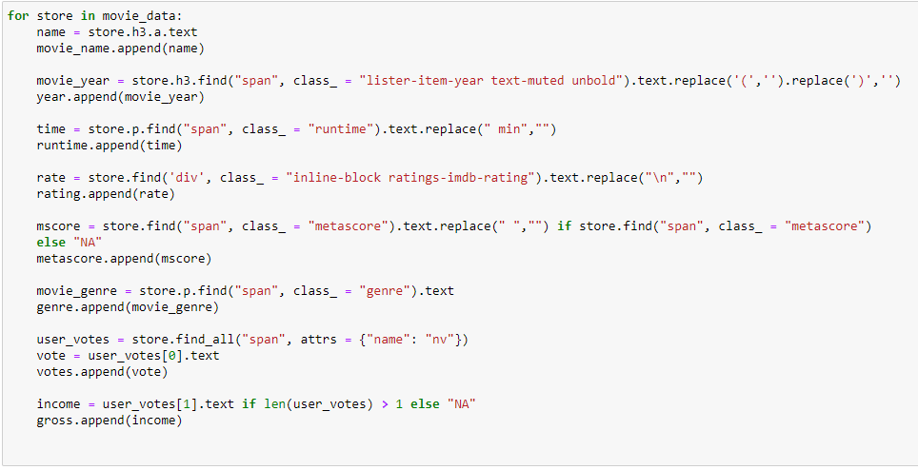
Back End Code
Then we iterate over all the attributes and by using loop we store the desired values in a variable.

Slide 12
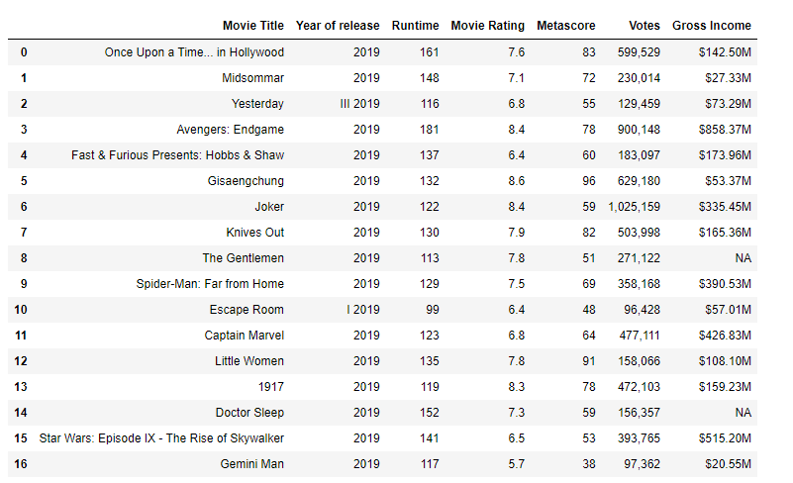
Back End Code
Once we scrape all the desired values we make a data frame.
Then we simply print the data frame and see the table with all the rows and columns

Slide 13
Middle Ware

Slide 14
Connectivity with SQL
SQL (Structured Query Language) is based on E. F. Codd’s Relational model and algebra to manage the relational databases. It’s a database query language used to create, insert, query, and manipulate the relational database and used by a large number of applications.
Here we are working with data in Python, by using pandas, we’ve got our data stored as a pandas DataFrame. We didn’t need to do any conversions to use SQL with our DataFrames; we directly inserted a pandas DataFrame into a MySQL database using sqlite3 library of python.

Slide 15
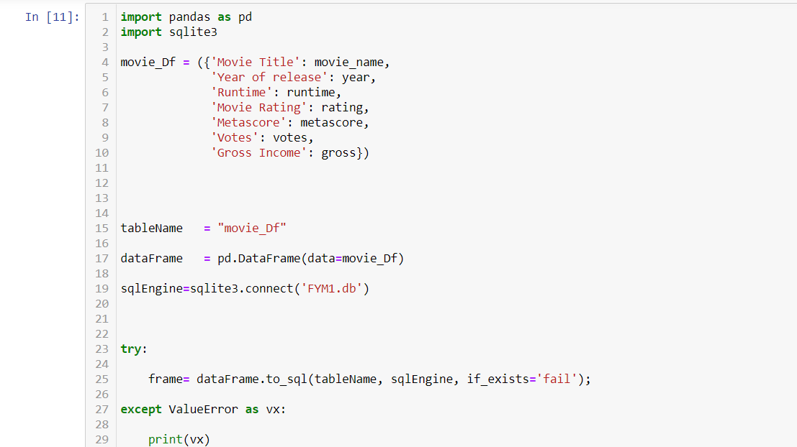
Middleware Code
Connectivity of the database with the backend

Slide 16
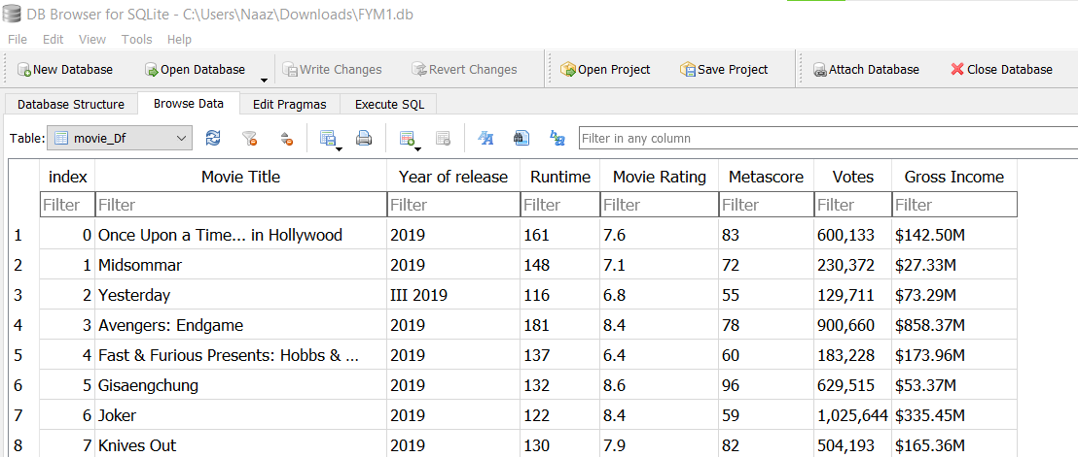
Middleware Code
Final Database formed after scraping data from the web

Slide 17
Front End

Slide 18
HTML, JAVASCRIPT, CSS & BOOTSTRAP
HTML: HTML is a standard markup language that provides the primary structure of a website. It work on the look of the website without the interactive effects and all.
JAVASCRIPT: JavaScript is an advanced programming language that makes web pages more interactive and dynamic. It simply adds dynamic content to websites to make them look good.
CSS: It is a language used to describes how HTML elements are to be displayed on a web page or layout of HTML documents like fonts, color, margin, padding, Height, Width, Background images, etc.
BOOTSTRAP: Bootstrap is a collection of CSS classes and JavaScript function and it is used for responsive design and building responsive, mobile-first site and application

Slide 19
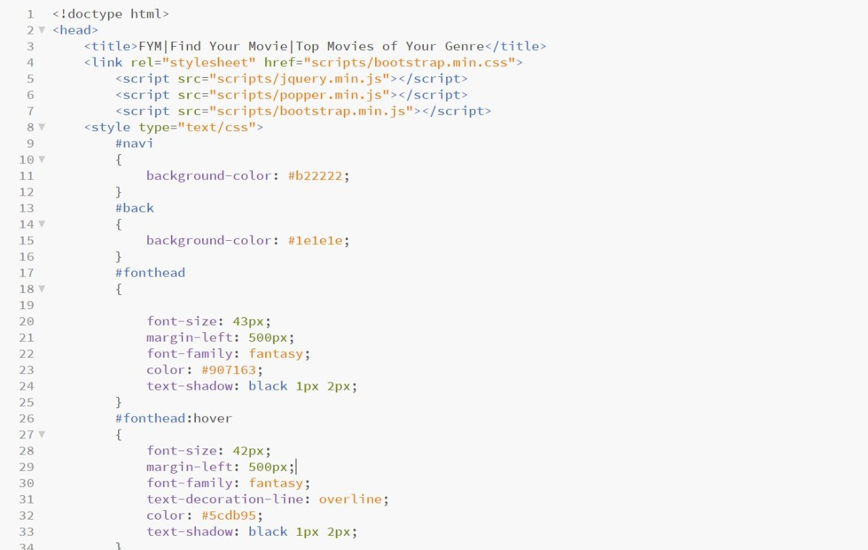
Front End Code
Here we used different scripts like bootstrap.min.css, jquery.min.js, popper.min.js and bootstrap.min.js.

Slide 20
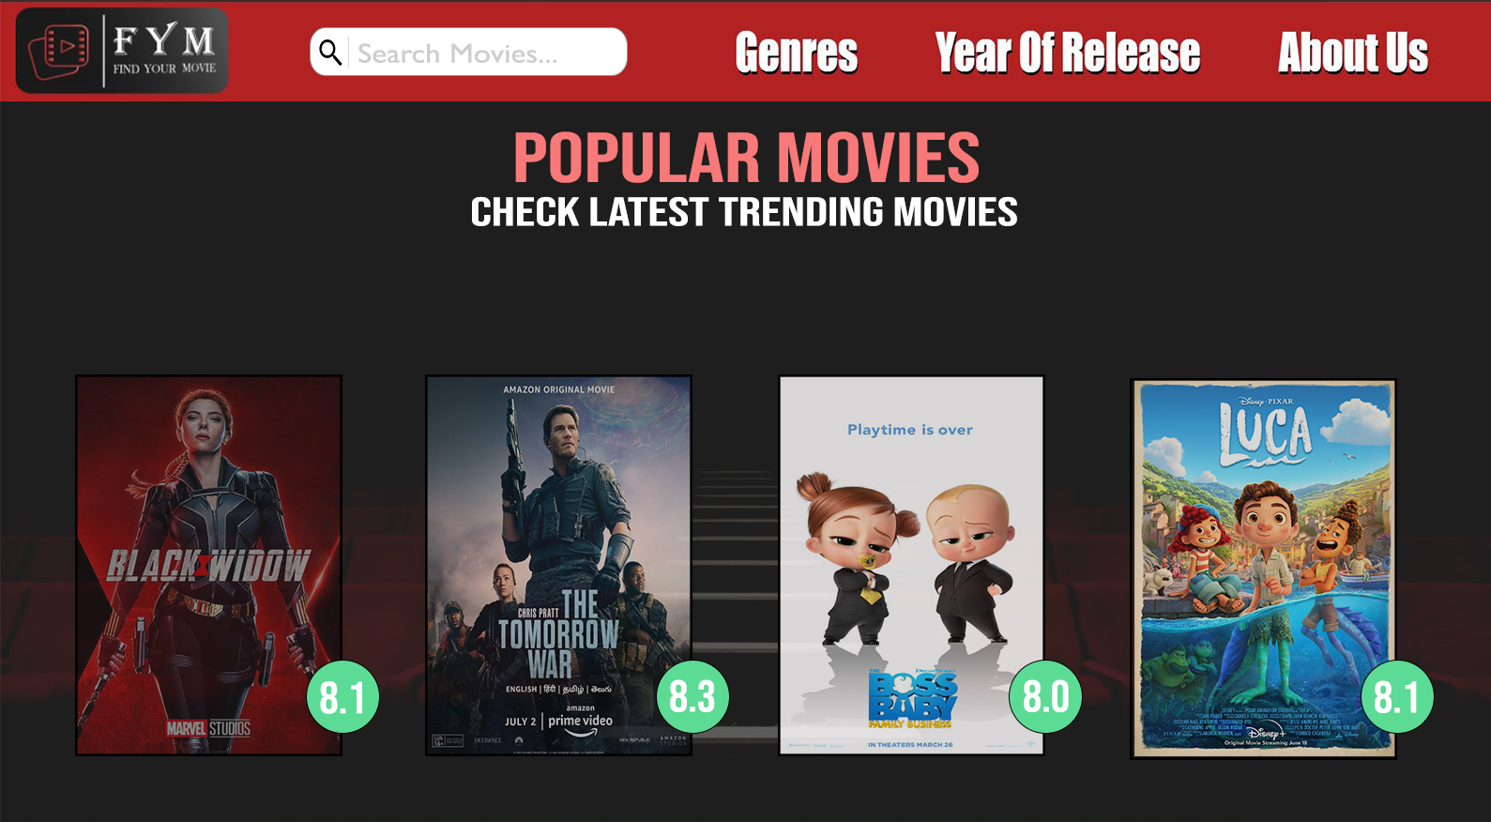
Webpage
Here we can see all the latest popular movies on the main page

Slide 21
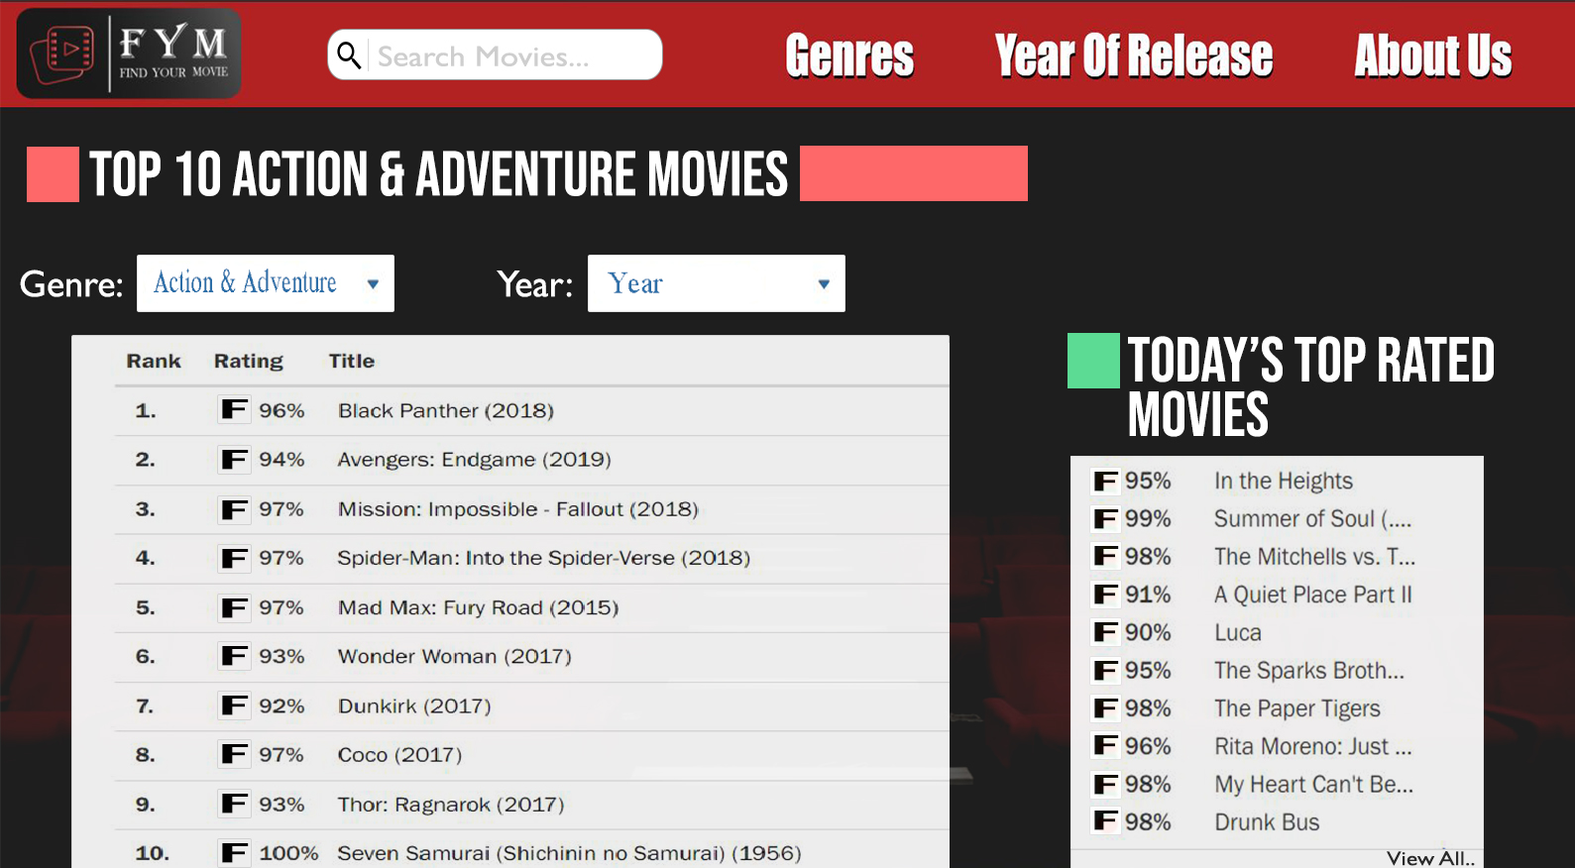
Webpage
On Scrolling down user can find these two dropdown menu options from where genre or year of the choice can be selected and Top movies will be shown accordingly.
Ask lesson
Correct homework
Send homework for tomorrow

Slide 22
Future Scope
We will be adding scraped data from more movie rating websites like Rotten Tomatoes, Movie Lens and many more.
We will be adding more filter options like language, region and others.
We will be adding more columns like movie description, actor list and directors to give a detailed view of the movie.
We will be adding upcoming movie slider.
We will also be expanding our current list of years and genres.
We will be adding a whole new category of TV series so that the same comfort for the Web series loving community.

Slide 23
Thank you!
Questions?

